Slide 2
9:00-9:30
9:30-9:40 break
9:40-10:10
10:10-10:20 break
10:20-10:50
10:50-11:00 break
11:00-11:30
11:30-11:40 break
11:40-12:10
12:10-12:20 break
12:20-1:00

Slide 3
LEARN To
RECOGNIZE
A GOOD
KNOWLEDGE
TRANCE
Notes:
explain who frank is

Slide 4
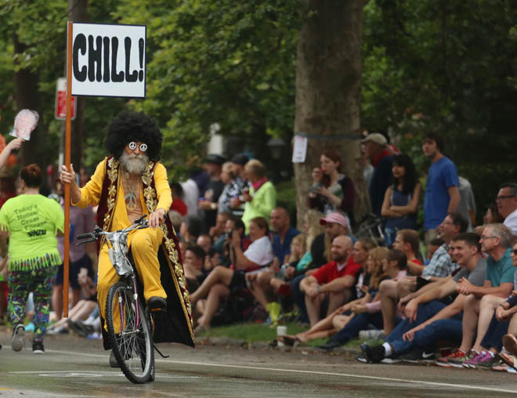

Slide 5
BREAK FROM THE BLUB
FIGHT IRONY
PERSEVERE
Notes:
Break from the blub: recognize the value of different approaches; avoid the generalist’s trap
Fight irony: e.g. brainfuck sucks
Persevere: google is useless, docs are very terse; stackoverflow: 1.4 mil javascript tags, 32k haskell, 8k prolog, 243 j

Slide 6


Slide 7
Motivation

Slide 8
Named-value model
Java, C, C++, C#, Javascript, Python, Ruby, PHP, Rust, Assembly, …
Necessitates sequencing of value updates!!
Programming with time…
Biductive computing
Prolog
Iterative distillation
Forth
Notes:
Clojure: datastructure transformations

Slide 9
Type threading
Haskell
Code generation
Lisp
Datastructure transformations
Clojure
Array computing
APL, J, K, Q
Notes:
Clojure: datastructure transformations

Slide 10
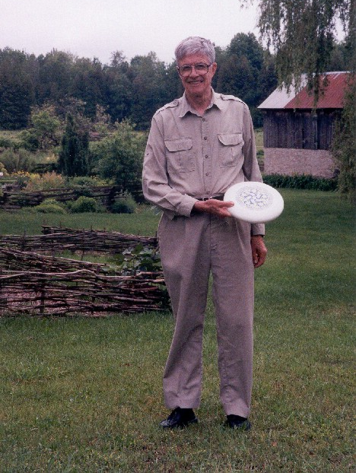
Notes:
“Ken at Kiln Farm with a prototype J Ultimate sportdisc (photo by Jana Michaud)”
http://webbox.lafayette.edu/~reiterc/j/ke_iverson/index.html

Slide 11
Incunabulum
typedef char C;typedef long I;
typedef struct a{I t,r,d[3],p[2];}*A;
#define P printf
#define R return
#define V1(f) A f(w)A w;
#define V2(f) A f(a,w)A a,w;
#define DO(n,x) {I i=0,_n=(n);for(;i<_n;++i){x;}}
I *ma(n){R(I*)malloc(n*4);}mv(d,s,n)I *d,*s;{DO(n,d[i]=s[i]);}
tr(r,d)I *d;{I z=1;DO(r,z=z*d[i]);R z;}
A ga(t,r,d)I *d;{A z=(A)ma(5+tr(r,d));z->t=t,z->r=r,mv(z->d,d,r);
R z;}
V1(iota){I n=*w->p;A z=ga(0,1,&n);DO(n,z->p[i]=i);R z;}
V2(plus){I r=w->r,*d=w->d,n=tr(r,d);A z=ga(0,r,d);
DO(n,z->p[i]=a->p[i]+w->p[i]);R z;}
V2(from){I r=w->r-1,*d=w->d+1,n=tr(r,d);
A z=ga(w->t,r,d);mv(z->p,w->p+(n**a->p),n);R z;}
V1(box){A z=ga(1,0,0);*z->p=(I)w;R z;}
V2(cat){I an=tr(a->r,a->d),wn=tr(w->r,w->d),n=an+wn;
A z=ga(w->t,1,&n);mv(z->p,a->p,an);mv(z->p+an,w->p,wn);R z;}
V2(find){}
V2(rsh){I r=a->r?*a->d:1,n=tr(r,a->p),wn=tr(w->r,w->d);
A z=ga(w->t,r,a->p);mv(z->p,w->p,wn=n>wn?wn:n);
if(n-=wn)mv(z->p+wn,z->p,n);R z;}
V1(sha){A z=ga(0,1,&w->r);mv(z->p,w->d,w->r);R z;}
V1(id){R w;}V1(size){A z=ga(0,0,0);*z->p=w->r?*w->d:1;R z;}
pi(i){P("%d ",i);}nl(){P("\n");}
pr(w)A w;{I r=w->r,*d=w->d,n=tr(r,d);DO(r,pi(d[i]));nl();
if(w->t)DO(n,P("< ");pr(w->p[i]))else DO(n,pi(w->p[i]));nl();}
C vt[]="+{~<#,";
A(*vd[])()={0,plus,from,find,0,rsh,cat},
(*vm[])()={0,id,size,iota,box,sha,0};
I st[26]; qp(a){R a>='a'&&a<='z';}qv(a){R a<'a';}
A ex(e)I *e;{I a=*e;
if(qp(a)){if(e[1]=='=')R st[a-'a']=ex(e+2);a= st[ a-'a'];}
R qv(a)?(*vm[a])(ex(e+1)):e[1]?(*vd[e[1]])(a,ex(e+2)):(A)a;}
noun(c){A z;if(c<'0'||c>'9')R 0;z=ga(0,0,0);*z->p=c-'0';R z;}
verb(c){I i=0;for(;vt[i];)if(vt[i++]==c)R i;R 0;}
I *wd(s)C *s;{I a,n=strlen(s),*e=ma(n+1);C c;
DO(n,e[i]=(a=noun(c=s[i]))?a:(a=verb(c))?a:c);e[n]=0;R e;}
main(){C s[99];while(gets(s))pr(ex(wd(s)));}
Notes:
One summer weekend in 1989, Arthur Whitney visited Ken Iverson at Kiln Farm and produced—on one page and in one afternoon—an interpreter fragment on the AT&T 3B1 computer. I studied this interpreter for about a week for its organization and programming style; and on Sunday, August 27, 1989, at about four o'clock in the afternoon, wrote the first line of code that became the implementation described in this document.
Arthur's one-page interpreter fragment is as follows.

Slide 12
Leaping head first into the stream of consciousness is good for your balance

Slide 13
Running a J program: No compiling. No linking.
No makefiles. No debugger required. You simply type J sentences and the interpreter executes them and displays any result.
J for C Programmers

Slide 14
Syntax

Slide 15
Statements are exactly one line long.
Numbers may be written 2, _2, 0.5, 5, 1e3, 2j5, 16b1f, 2p1, _, __
Adjacent numbers make a list: 3 5 2e3 7
Strings have single-quotes: 'hello'
Everything else is a built-in or user-defined word:
Verbs: +, -, etc.
Adverbs: ~, /, }, etc.
Conjunctions: ^:, ", @, &, etc.
Others: =., =:, NB., etc.
Notes:
2p1: 2*pi^1
2p5: 2*pi^5

Slide 16
You do not need to trouble yourself with the distinction between integers, floats, and complex numbers. If it’s a number, J will handle it properly.
J for C Programmers

Slide 17
Evaluation Rules

Slide 18
Forget the table of operator precedence!
J for C Programmers

Slide 19
RTL Evaluation:
2*4+5
18
2+4*5
22
(2*4)+5
13
Notes:
No precedence rules except parentheses ()

Slide 20

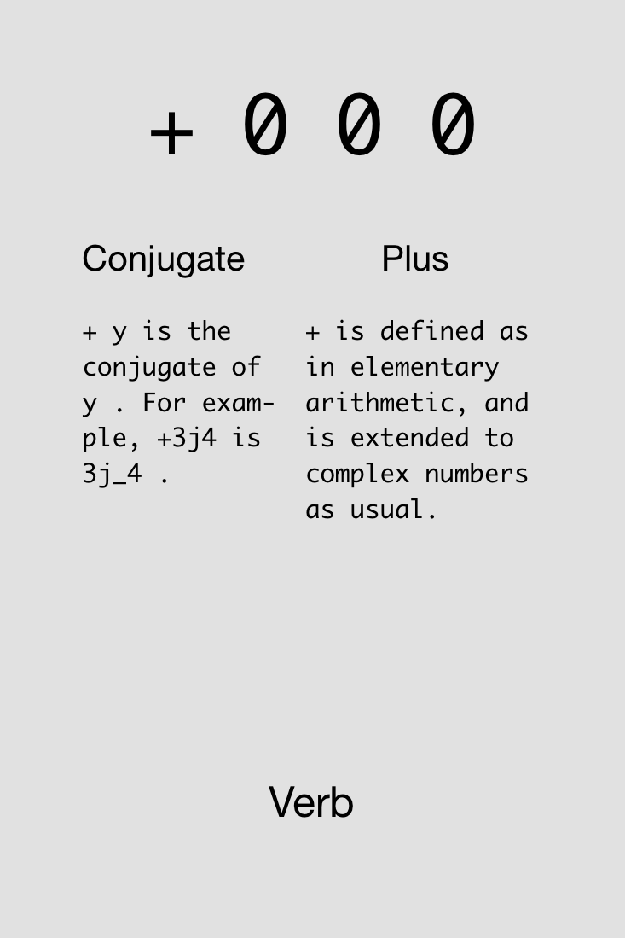
Notes:
Show example in J: 4+5+2

Slide 21

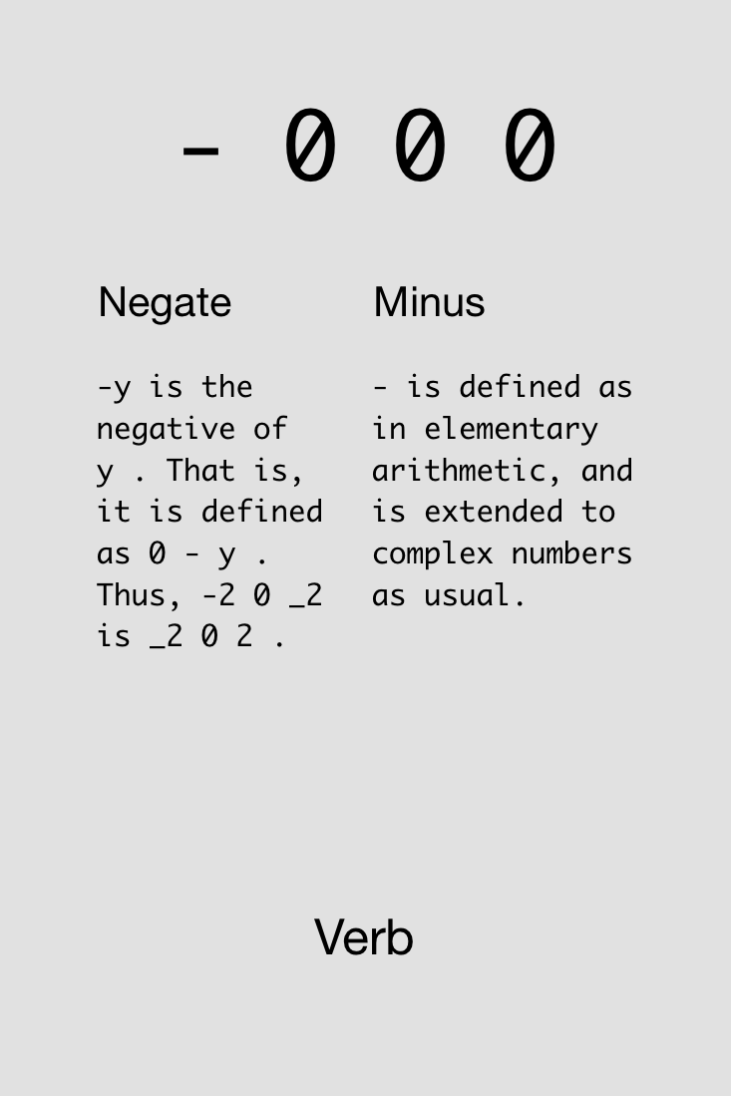

Slide 22

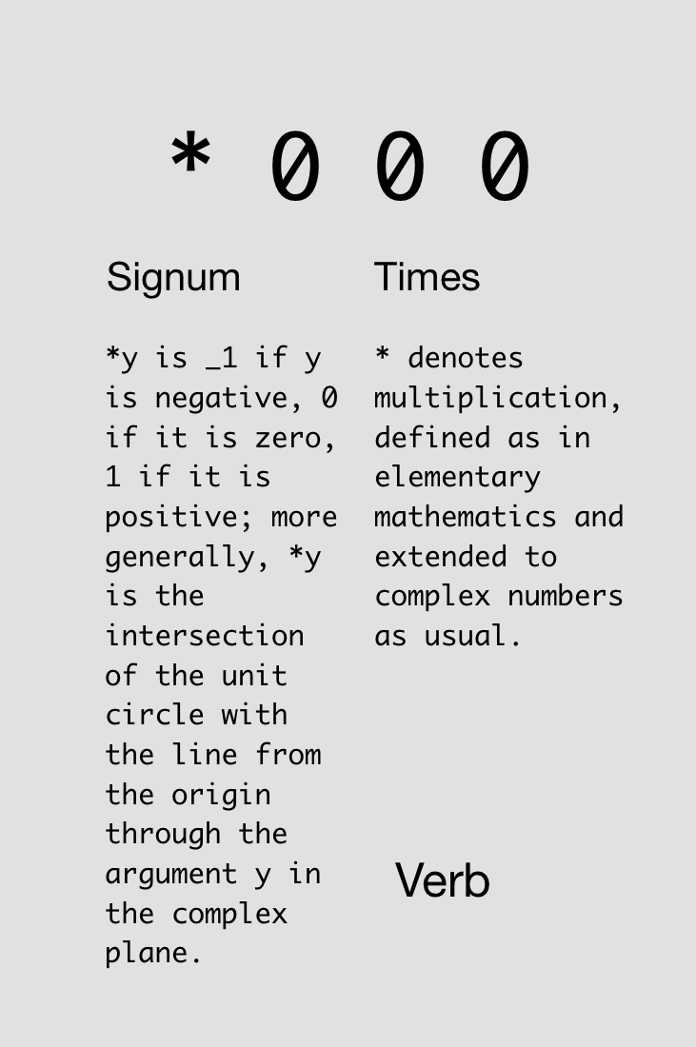

Slide 23

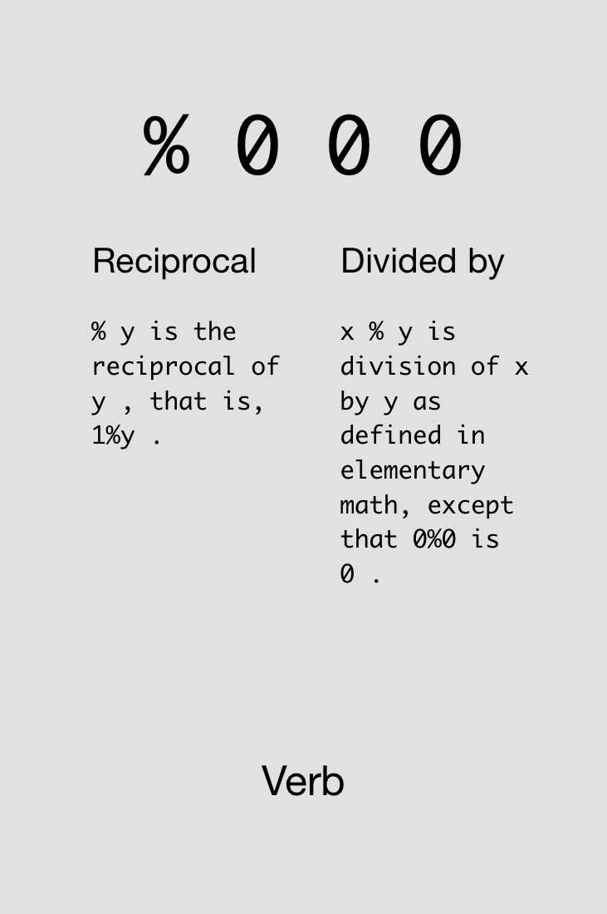

Slide 24
Monads & Dyads

Slide 25
y is right arg
x is left arg,
y is right arg

Slide 26
Monad vs. Dyad %:
2%7
0.285714
7%2
3.5
%7
0.142857
%2
0.5

Slide 27

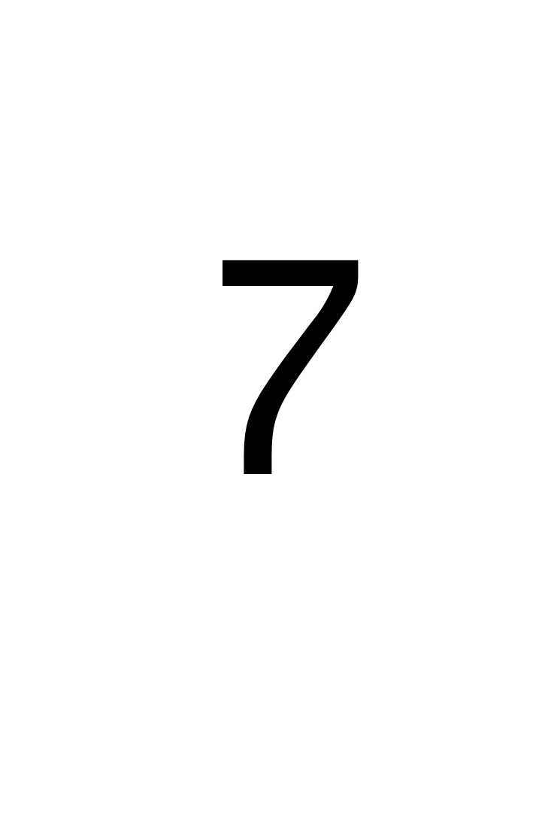
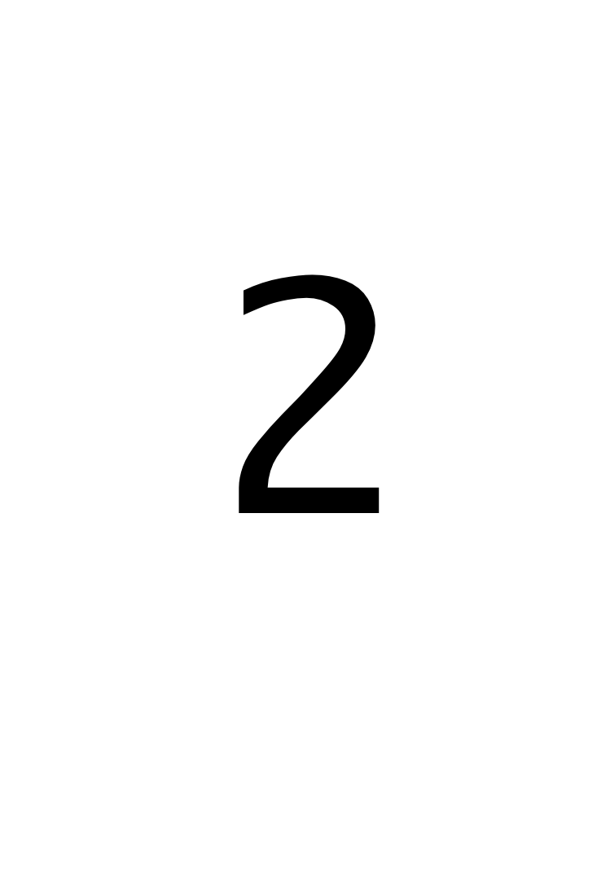


Challenge!
Compute the arithmetic mean of 4 and 7.
Find three solutions using all of these cards simultaneously:
3x
3x
4x
3x
5x
2x
2x

Slide 28
Solutions!
Compute the arithmetic mean of 4 and 7.

Slide 29

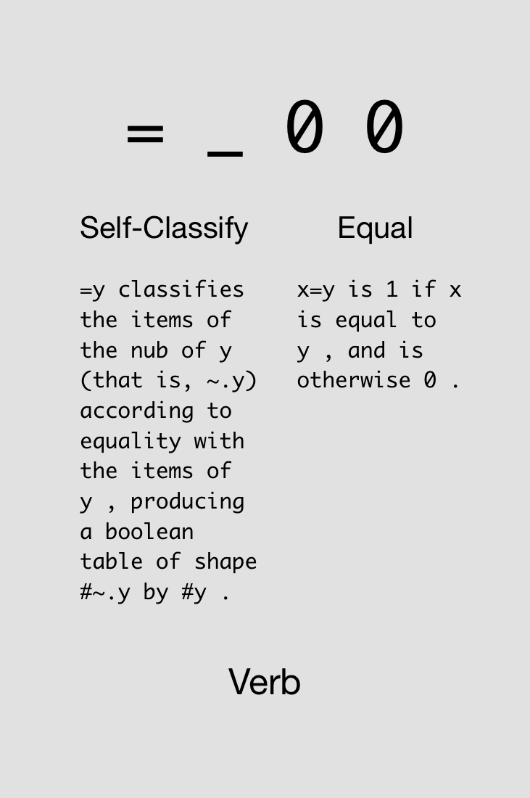

Slide 30

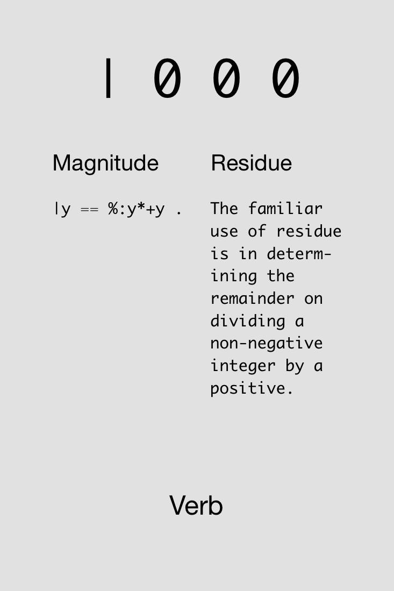

Slide 31

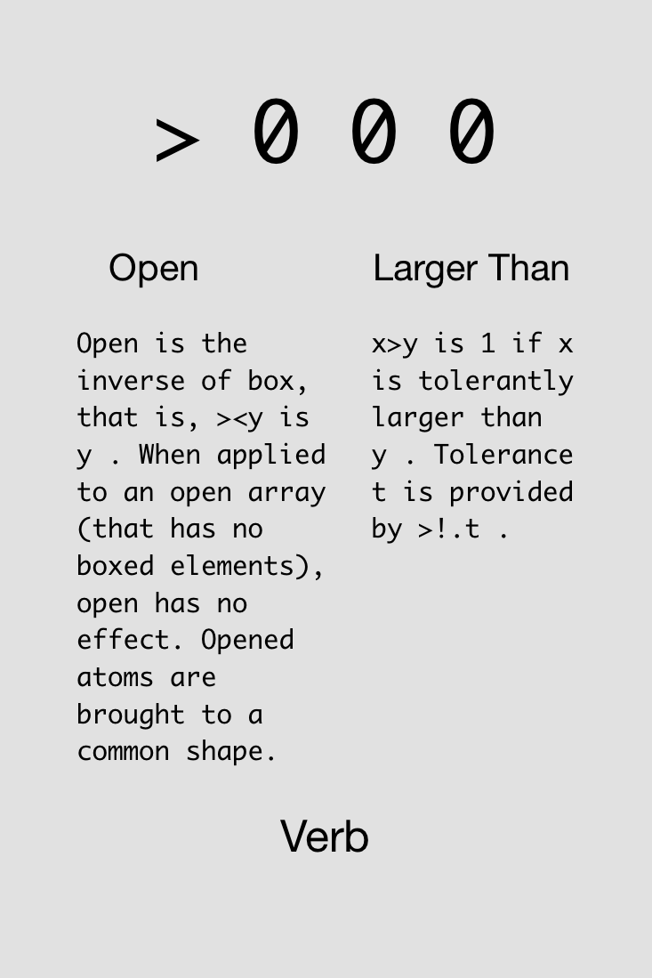

Slide 32

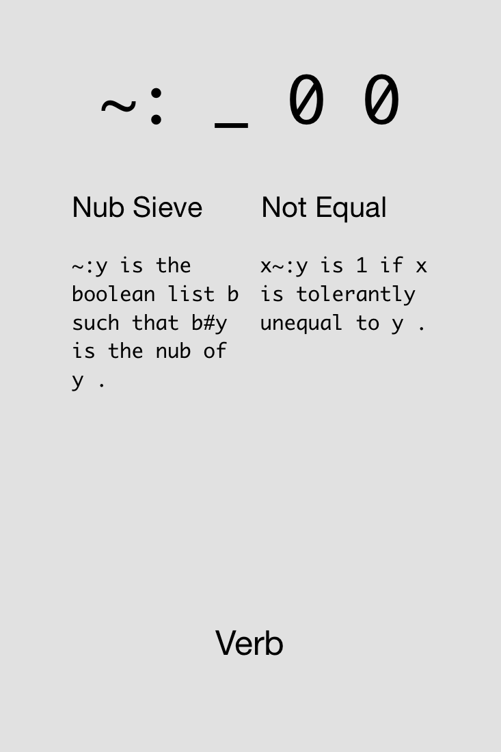

Slide 33

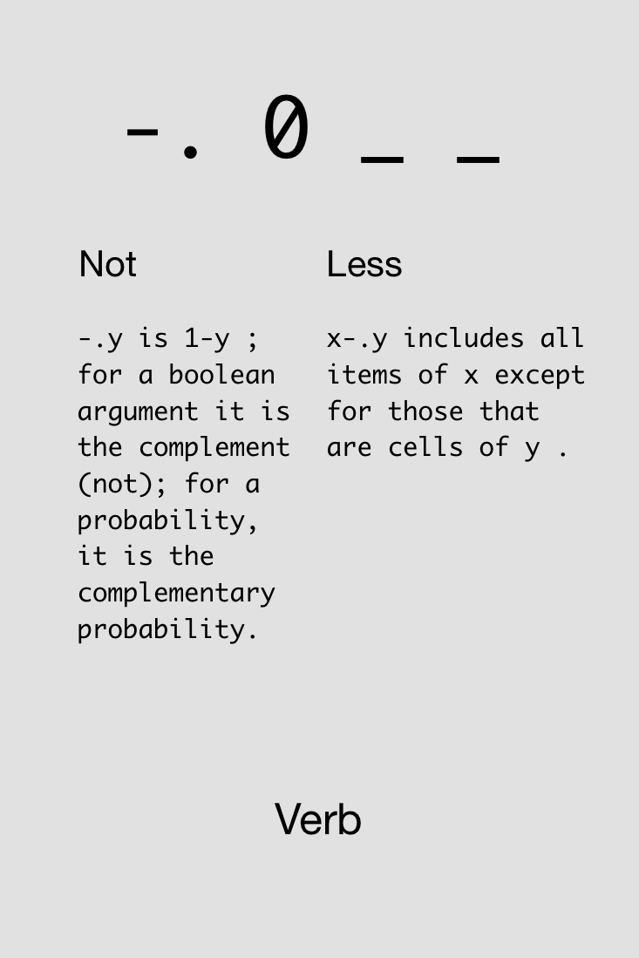

Slide 34



Challenge!
Compute whether a number, say 8, is even (gives 1 if even, 0 otherwise).
Find four solutions using all of these cards simultaneously:
1x
2x
4x
1x
4x
4x
1x
1x
1x

Slide 35
Solutions!
Compute whether a number, say 8, is even (gives 1 if even, 0 otherwise).

Slide 37
Try not to reinvent the rut

Slide 38
Arrays

Slide 39
Any variable can be an array. As for what the type and dimensioning is: you assigned the variable, didn't you? It contains whatever you put into it, a number, a string, an array, a structure... J will remember. If your program logic requires you to find out the current attributes of a variable, J can tell you.
J for C Programmers

Slide 40
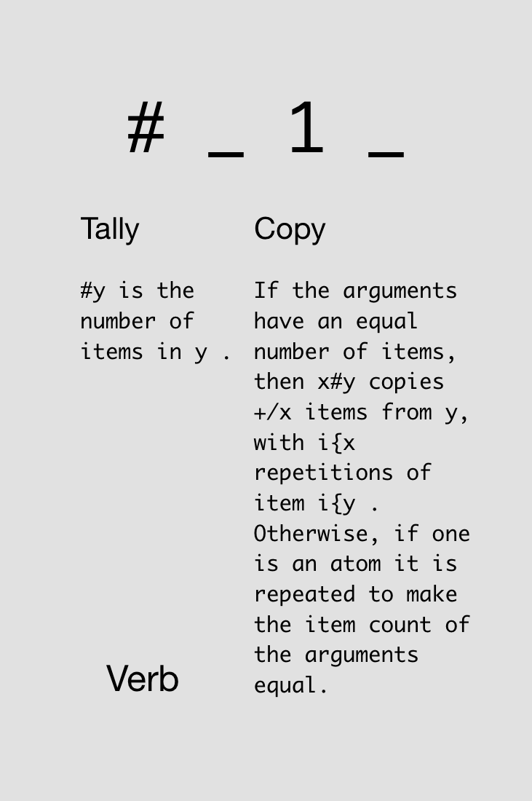

Notes:
Just monadic form

Slide 41
Variable assignment and array size:
a =: 5 3 7 9
a
5 3 7 9
#a
4
s =: 'hello'
#s
5

Slide 42
In J, every operator has a loop built in.
J for C Programmers

Slide 43
Automatic element-by-element operations:
1 2 3 + 4 5 6
5 7 9
1 + 4 5 6
5 6 7
1 2 + 4 5 6
|length error
| 1 2 +4 5 6

Slide 44
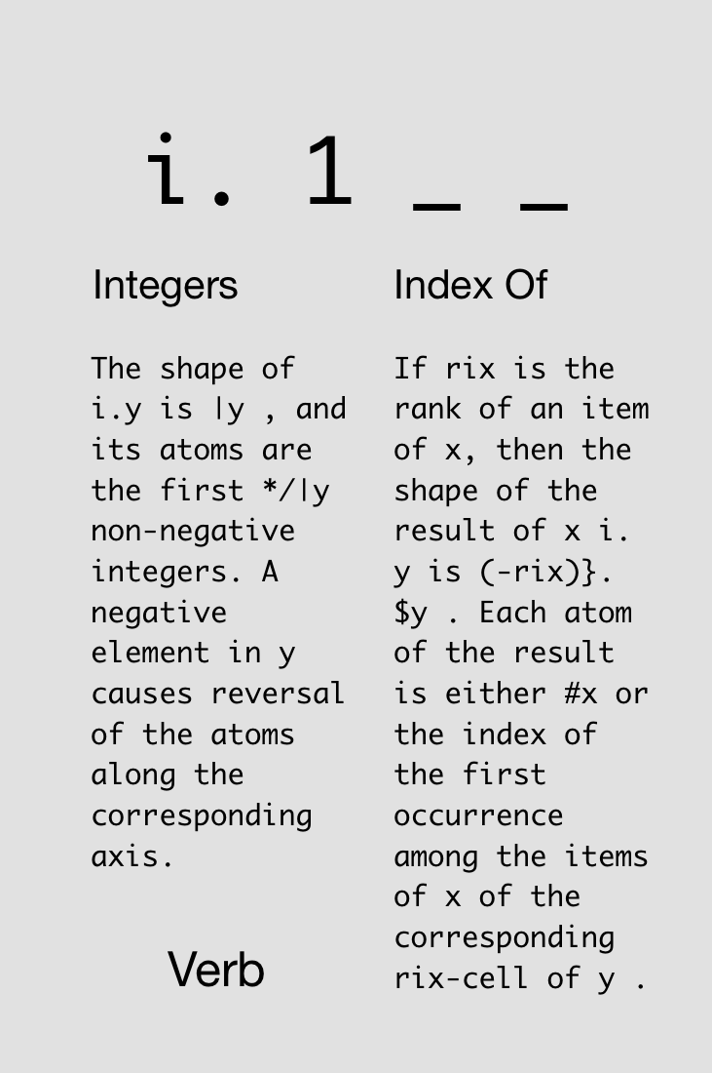


Slide 45
Notes:
Now dyadic form

Slide 46
i.4
0 1 2 3
3+i.4
3 4 5 6
3#i.4
0 0 0 1 1 1 2 2 2 3 3 3
#3#i.4
12
3##i.4
4 4 4

Slide 47
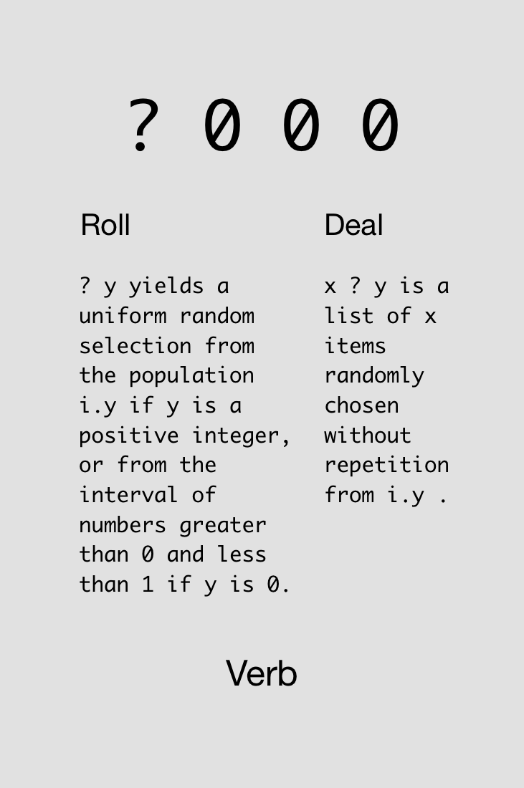



Slide 48
?5
1
?5
4
?0
0.654682
?5 2 3 6
3 1 0 4
3?7
1 4 2

Slide 49



Challenge!
Roll five d20 dice with +3 modifiers on all rolls.
Find four solutions using all of these cards simultaneously:
4x
4x
4x
4x
4x
4x
4x
2x
Notes:
>: intentionally not described ahead of time

Slide 50
Solutions!
Roll five d20 dice with +3 modifiers on all rolls.

Slide 51
Solutions!
Roll five d20 dice with +3 modifiers on all rolls.

Slide 52
Adverbs
Notes:
Loopless coding

Slide 53
A noun holds data; a verb operates on one or two nouns to produce a result which is a noun; an adverb operates on one noun or verb to produce a derived entity.
J for C Programmers

Slide 54
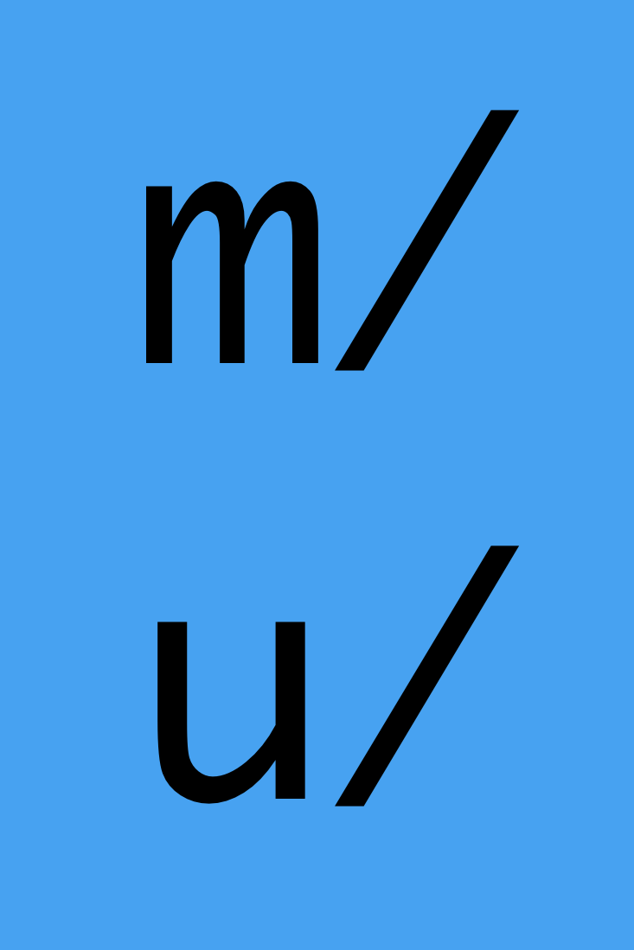
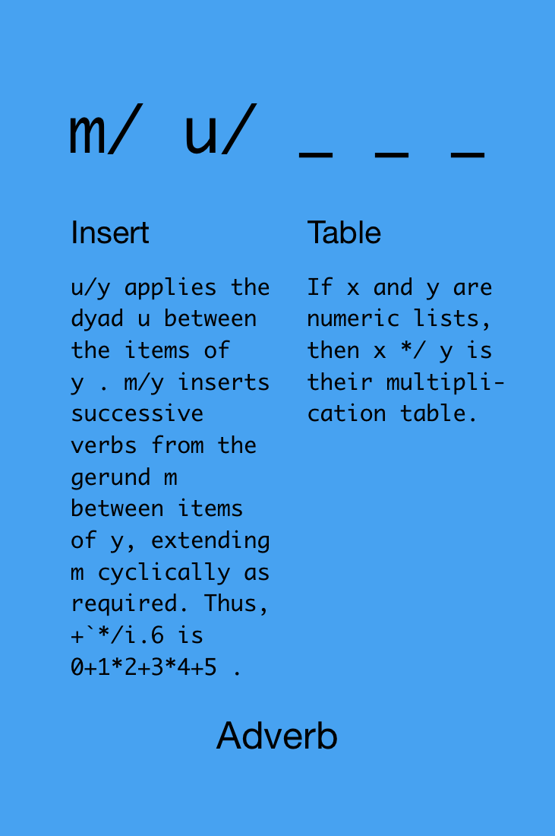

Slide 55
1+2+3+4+5
15
+/1 2 3 4 5
15
*/1 2 3 4 5
120

Slide 56
New version of “arithmetic mean”:
vals=:3 _4 7 9 _2 3
+/vals
16
#vals
6
(+/vals)%(#vals)
2.66667
+/vals%#vals
2.66667

Slide 57

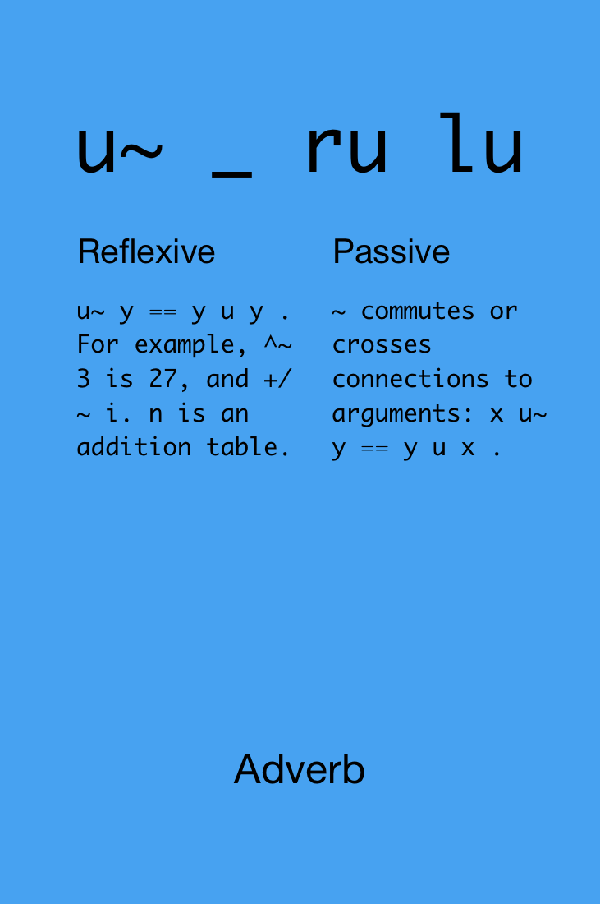
Notes:
ru = rank of right side of u
lu = rank of left side of u
(flipped!)

Slide 58

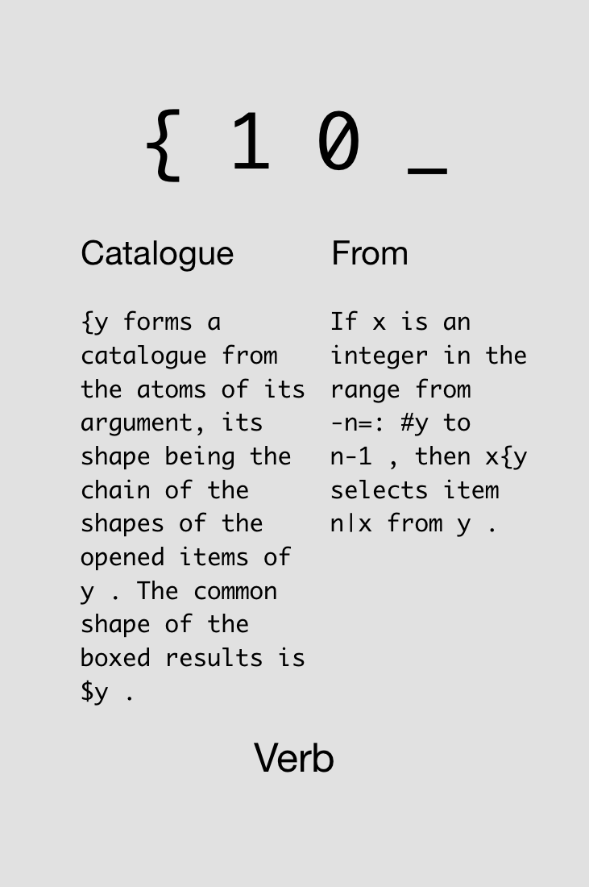
Notes:
“-n=: #y to n-1” means: from (first let n=4) -4 to 3

Slide 59



Challenge!
Given a string (or any array) s, determine if it’s a palindrome.
Find two solutions using all of these cards simultaneously:
5x
s
1x
1x
1x
2x
1x
1x
1x
1x
1x
2x
Notes:
|. intentionally not described ahead of time

Slide 60
Solutions!
Given a string (or any array) s, determine if it’s a palindrome.
s
s
s
s

Slide 62
Never put a seat belt around your intuition

Slide 63
Atoms, Lists,
Tables, et al.

Slide 64
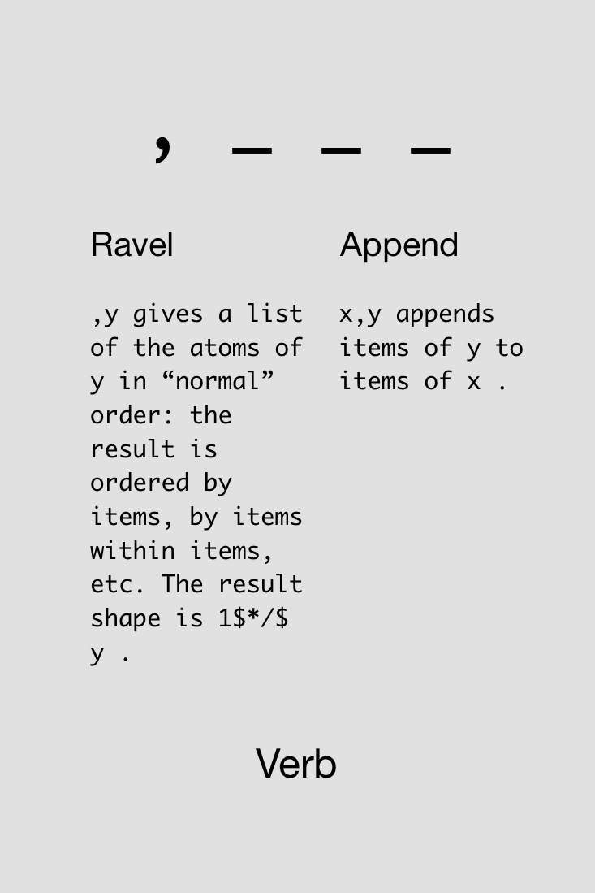

Slide 65
(i.3) (i.5)
|syntax error
| (i.3)(i.5)
(i.3),(i.5)
0 1 2 0 1 2 3 4

Slide 66

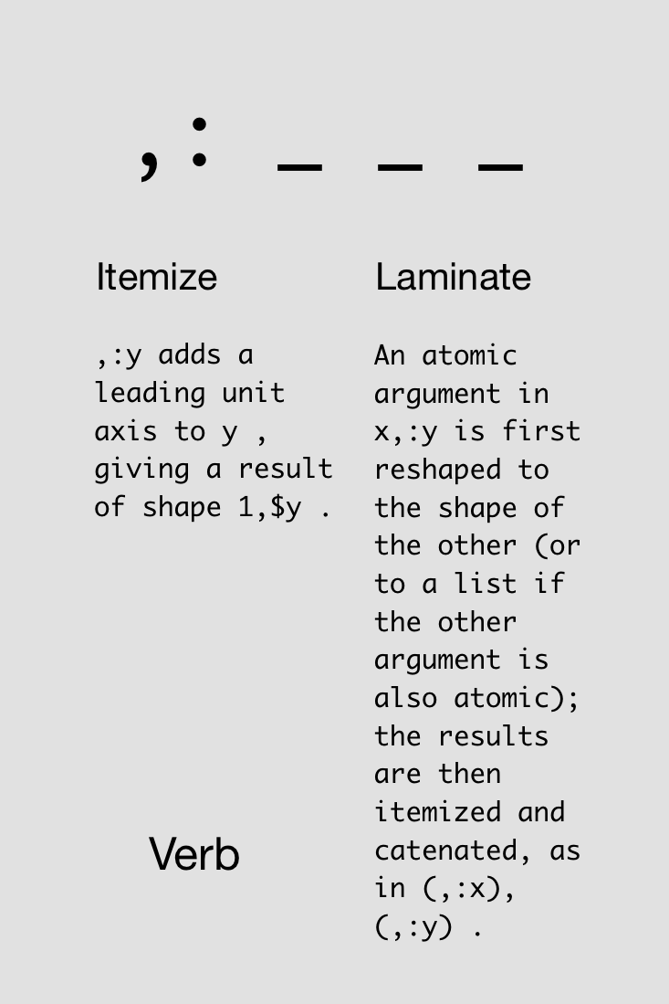

Slide 67
pt1 =: 5.1 3.5 1.4 0.2
pt2 =: 4.9 3.0 1.4 0.2
pt3 =: 4.7 3.2 1.3 0.2
pt1 , pt2 , pt3
5.1 3.5 1.4 0.2 4.9 3 1.4 0.2 4.7 3.2 1.3 0.2
pt1 , pt2 ,: pt3
5.1 3.5 1.4 0.2
4.9 3 1.4 0.2
4.7 3.2 1.3 0.2

Slide 68

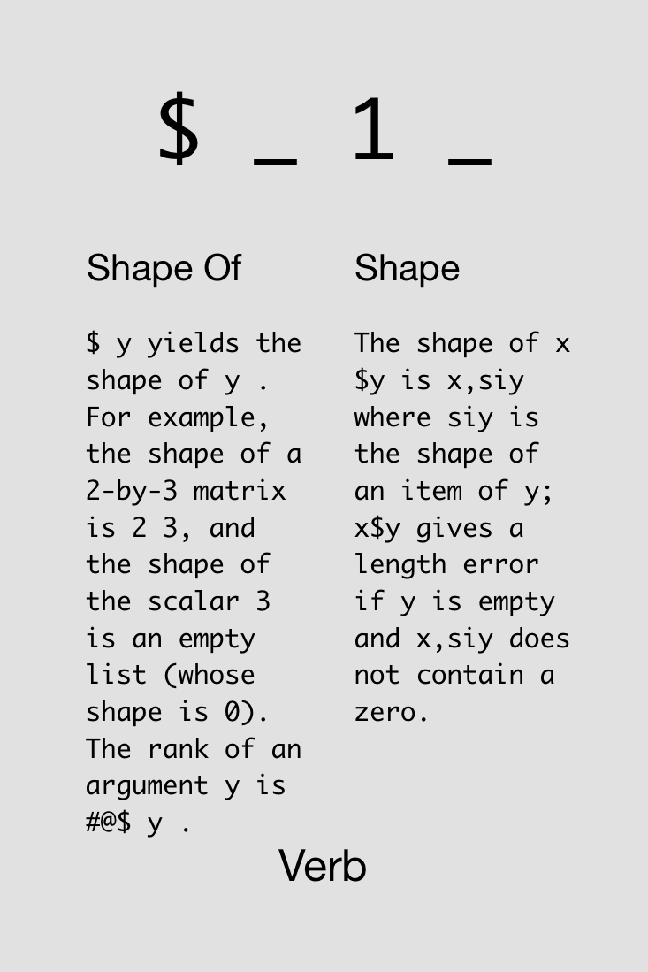

Slide 69
Rank

Slide 70
The rank of a noun is the count of its axes. An atom has rank 0, a list rank 1, a table rank 2, and an array with 5 axes has rank 5.
J Primer

Slide 71
100 200 300 + (1 2 3 4)
|length error
| 100 200 300 +(1 2 3 4)
100 200 300 +"0 _ (1 2 3 4)
101 102 103 104
201 202 203 204
301 302 303 304
100 200 300 +"_ 0 (1 2 3 4)
101 201 301
102 202 302
103 203 303
104 204 304

Slide 72
If you don’t know the rank of a verb, you don’t know the verb. Using a verb of unknown rank is like wiring in a power-supply of unknown voltage–it will do something when you plug it in; it might even work; but if the voltage is wrong it will destroy what it’s connected to. Avoid embarrassment! Know the rank of the verbs you use.
J Primer

Slide 73
Ask the rank of a verb.
+ b.0
0 0 0
- b.0
0 0 0
i. b.0
1 _ _
$ b.0
_ 1 _
,: b.0
_ _ _

Slide 74
Ask the rank of a verb.
/ b.0
|syntax error
| /b.0
+/ b.0
_ _ _

Slide 75
Challenge!
Compute the average of every row in a table.
TODO: Find two solutions using all of these cards simultaneously:
5x
s
1x
1x
1x
2x
1x
1x
1x
1x
1x
2x

Slide 77
If you’re lucky enough to experience a miracle,
try not to micro manage it

Slide 78
Recursion

Slide 79
Recursive “Larger of” >.
vals=:4 3 2 $ 24?100
>./vals
96 95
70 85
60 89
>./>./vals
96 95
>./>./>./vals
96
>./^:3 vals NB. recursive application, 3 times
96
>./^:_ vals NB. 'limit' of >./, works on any shape
96

Slide 81
Devalue having

Slide 82
Hooks & Forks

Slide 83
Hooks
fg
Monadic
fg y == y f (g y)
-% y == y - (% y)
Dyadic
x fg y == x f (g y)
x -% y == x - (% y)

Slide 84
Forks
fgh
Monadic
fgh y == (f y) g (h y)
-+% y == (- y) + (% y)
Dyadic
x fgh y == (x f y) g (x h y)
x -+% y == (x – y) + (x % y)

Slide 85
Challenge!
TODO: Define the L² norm (Euclidean distance) as a dyadic verb.
TODO: Find two solutions using all of these cards simultaneously:
5x
s
1x
1x
1x
2x
1x
1x
1x
1x
1x
2x

Slide 86
Conjunctions

Slide 87
J uses the names x, y, u, v, m, and n to represent arguments to verbs and other entities. You should avoid using these names for other purposes.
J for C Programmers
Notes:
x, y: verb args (left, right)
u, v: verbs
m, n: nouns

Slide 88

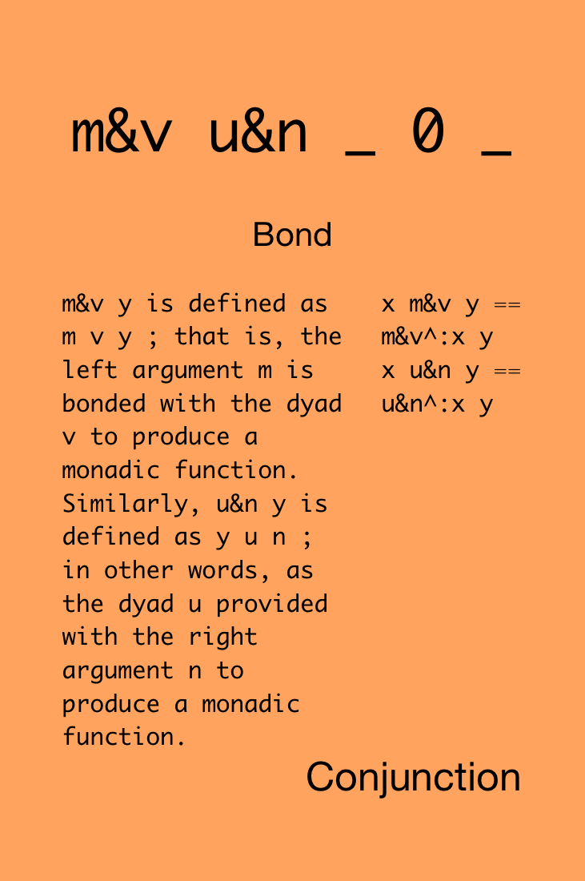

Slide 89
f =: 5&+
f 1 2 3 4 5
6 7 8 9 10
g =: -&5
g 1 2 3 4 5
_4 _3 _2 _1 0
2 f 1 2 3 4 5 NB. recursively applies 5&+ twice
11 12 13 14 15
3 g 1 2 3 4 5 NB. recursively applies -&5 three times
_14 _13 _12 _11 _10

Slide 90

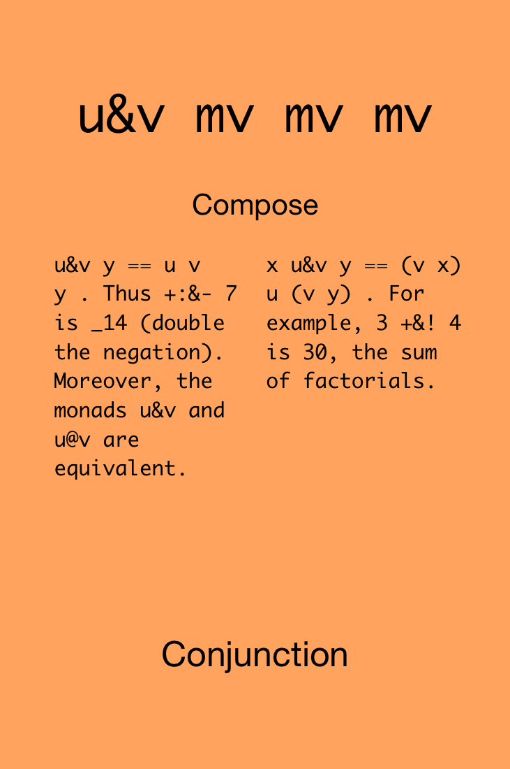

Slide 91
f =: -&% NB. i.e., - (% y)
f 1 2 3 4 5
_1 _0.5 _0.333333 _0.25 _0.2
g =: -% NB. compare with hook
g 1 2 3 4 5 NB. i.e., y - (% y)
0 1.5 2.66667 3.75 4.8
10 f 1 2 3 4 5 NB. i.e., (%x)-(%y)
_0.9 _0.4 _0.233333 _0.15 _0.1

Slide 92

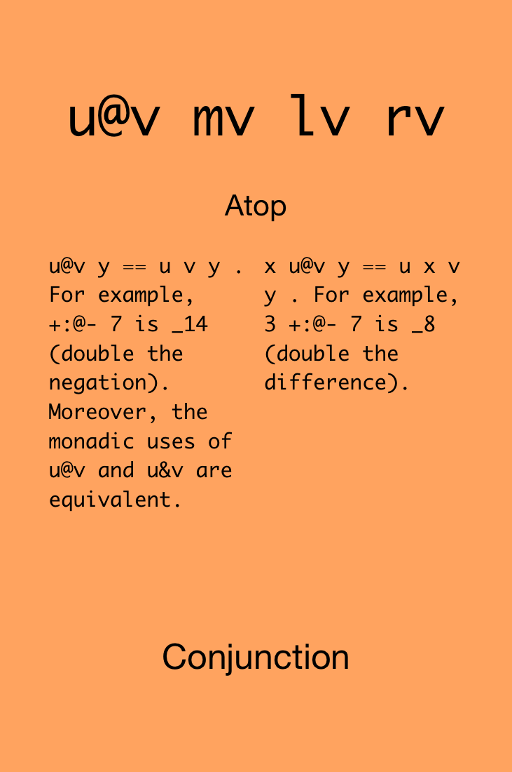

Slide 93
f =: -@% NB. same as & in monadic form
f 1 2 3 4 5
_1 _0.5 _0.333333 _0.25 _0.2
10 f 1 2 3 4 5 NB. i.e., - (x % y)
_10 _5 _3.33333 _2.5 _2
f =: +/@% NB. @ rank is rank of v (%)
f 1 2 3 4 5 NB. thus, +/ receives atoms
1 0.5 0.333333 0.25 0.2
f =: +/@(%"1) NB. force v to have rank 1 1 1
f 1 2 3 4 5 NB. so now +/ receives lists
2.28333

Slide 94
Challenge!
Define the L² norm (Euclidean distance) as a dyadic verb.
TODO: Find two solutions using all of these cards simultaneously:
5x
s
1x
1x
1x
2x
1x
1x
1x
1x
1x
2x

Slide 96
Avoid both picking at minutia and sideswiping mountains

Slide 97
Big Data

Slide 98
You may at first worry that you're using too much memory, or that you might misuse the processor's caches; get over it. Apply verbs to large operands.
J for C Programmers

Slide 99
Visualization

Slide 100
load '~addons/graphics/fvj4/dwin.ijs'
_1 _1 1 1 dwin 'fun' NB. open window, -1:1 axes
1 o. 1r6p1 NB. sine(1/6 pi^1)
0.5
2 o. 1r6p1 NB. cosine(1/6 pi^1)
0.866025
NB. define x,y coordinates of a circle with 200 pts
circ =: |: 2 1 o./ 1r100p1*i.200
1 0
0.999507 0.0314108
0.998027 0.0627905
0.995562 0.0941083
...

Slide 101
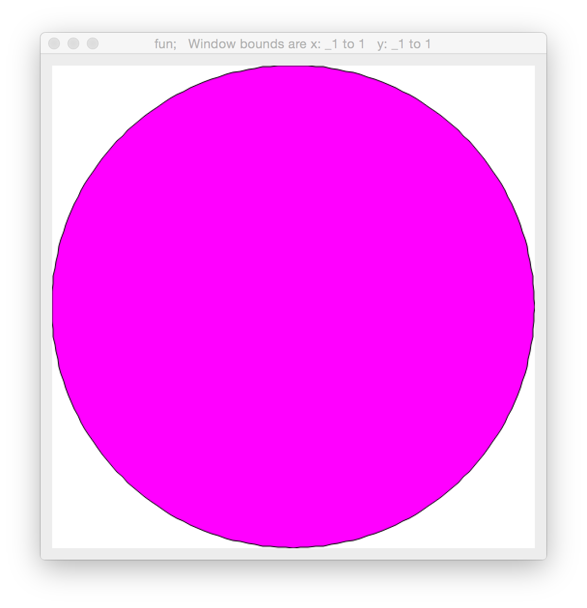
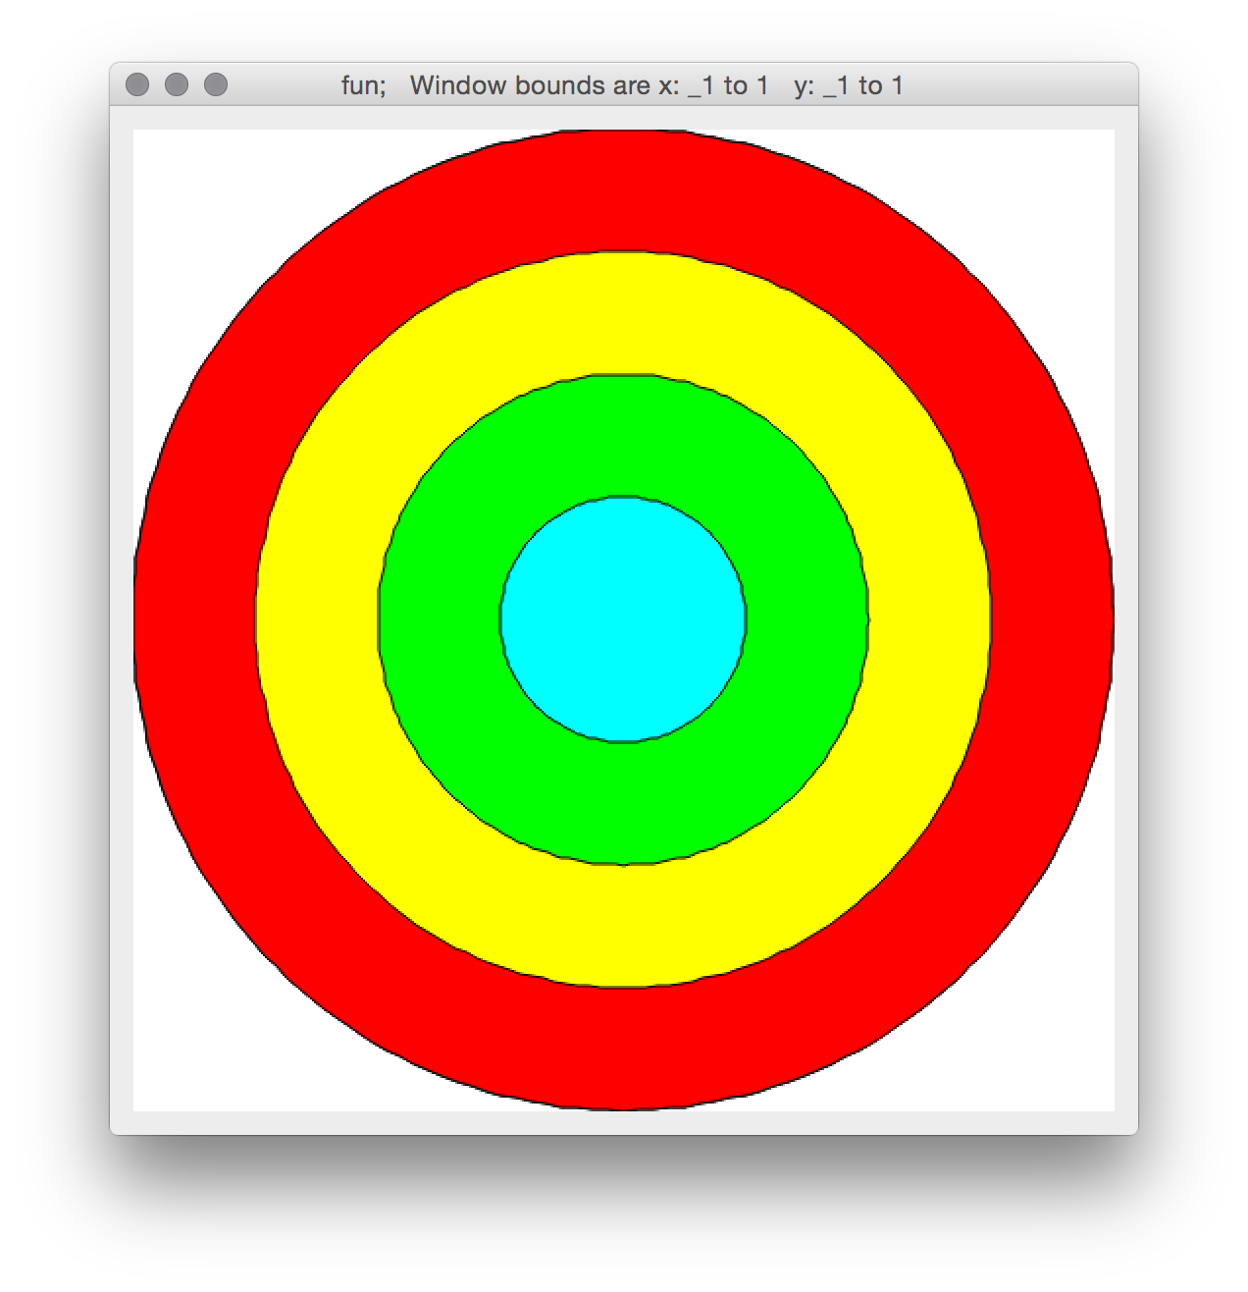
NB. plot a circle with a color
255 0 255 dpoly circ
circ4 =: 1 0.75 0.5 0.25 */ circ NB. four circles
colr4 =: 255 0 0, 255 255 0, 0 255 0,: 0 255 255
NB. plot four circles with individual colors
colr4 dpoly circ4

Slide 102
NB. generate some x,y exponential values
|: (i.10) ,: (^ 0.1 * i.10) % 10
0 0.1
1 0.110517
2 0.12214
...
NB. scale values, and reflect y values
xs =: (0.5 -~ 0.005 * i.200)
ys =: ((|. (^0.1*i.100)), (^0.1*i.100))%100
curve =: |: xs ,: ys

Slide 103
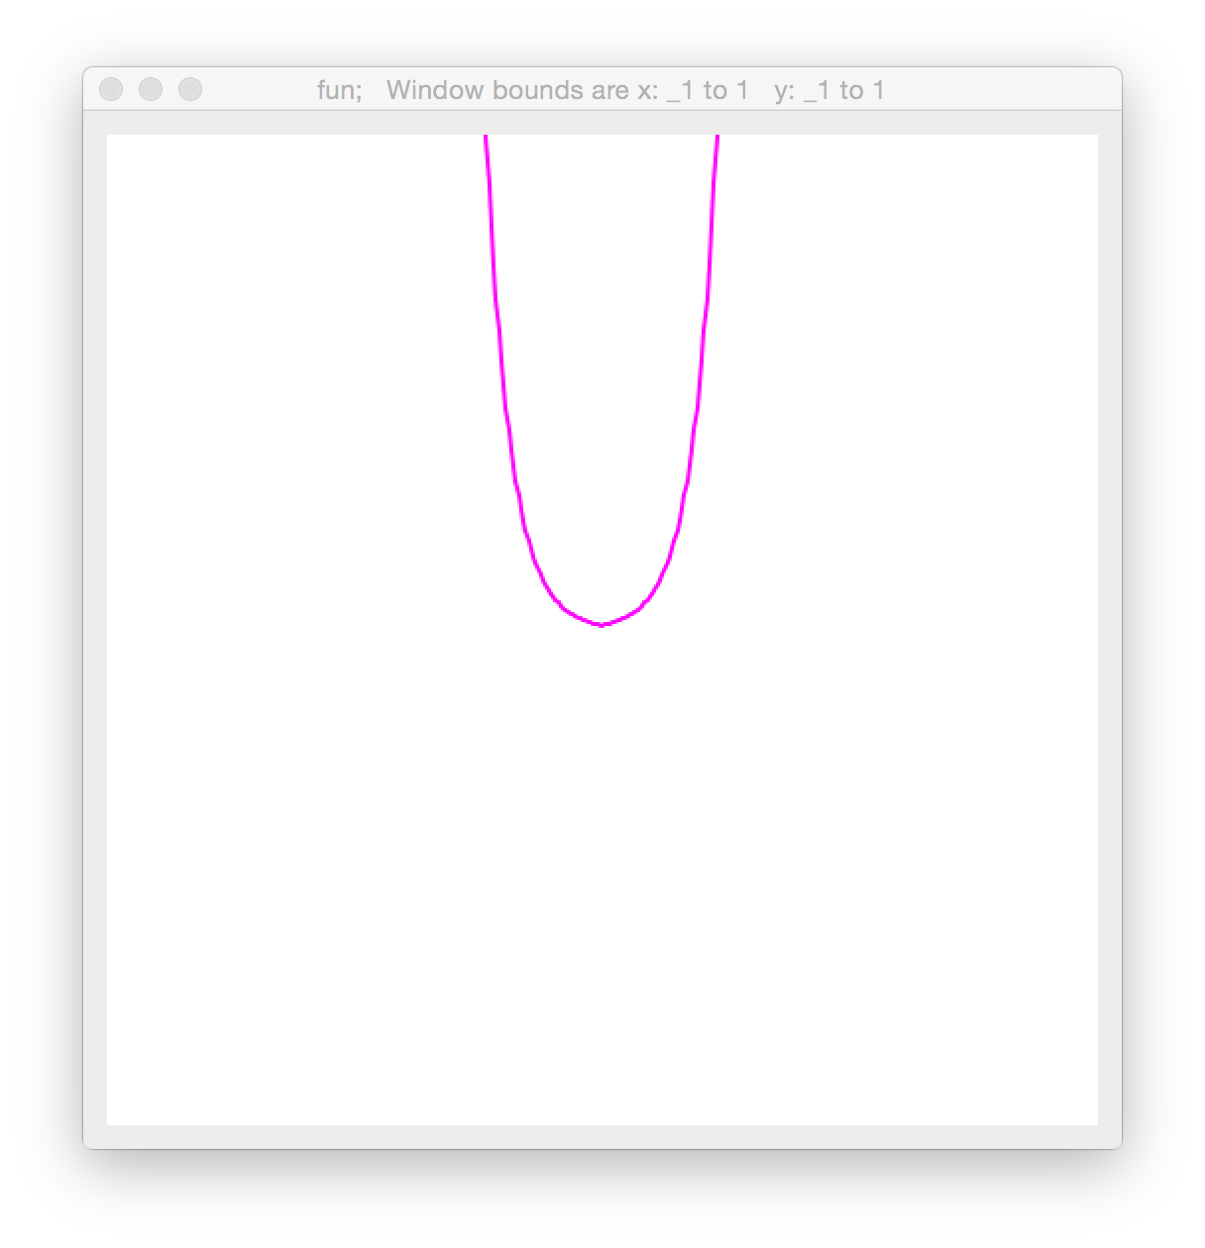
curve
_0.5 199.304
_0.495 180.337
_0.49 163.176
...
_0.01 0.0110517
_0.005 0.01
0 0.01
0.005 0.0110517
...
0.49 180.337
0.495 199.304
NB. plot the curve
255 0 255 dline curve

Slide 104
Rotation can be defined as matrix multiplication of vector representing the point: [x,y,1] and a rotation matrix:
M = [ cos(𝜃) -sin(𝜃) 0
sin(𝜃) cos(𝜃) 0
0 0 1 ]
After multiply M*[x,y,1]^{T}, the result will be [x’,y’,z]; divide z out of x’ and y’ to get final coordinates. In our case, however, z will always be 1.
NB. define matrix mult.
mp =: +/ . *
NB. use simple trig names
load 'trig'
NB. define rotation matrix
rotm =: (cos , sin , 0:),
(-@sin , cos , 0:),:
(0: , 0: , 1:)
rotm 1r4p1
0.707107 0.707107 0
_0.707107 0.707107 0
0 0 1
Notes:
Why is mp defined that way? It’s complicated.

Slide 105
Likewise, a translation matrix is defined as:
M = [ 1 0 xtrans
0 1 ytrans
0 0 1 ]
Translation & rotation matrices can be combined with matrix multiplication, e.g., TransM * RotM * [x,y,1]^{T}
NB. trans. matrix as verb
trans =: monad define
1 0 0, 0 1 0,: (y,1)
)
trans 5 2
1 0 0
0 1 0
5 2 1
(trans 5 2) mp (rotm 1r4p1)
0.707107 0.707107 0
_0.707107 0.707107 0
2.12132 4.94975 1
(3,2,1) mp (... above ...)
2.82843 8.48528 1

Slide 106
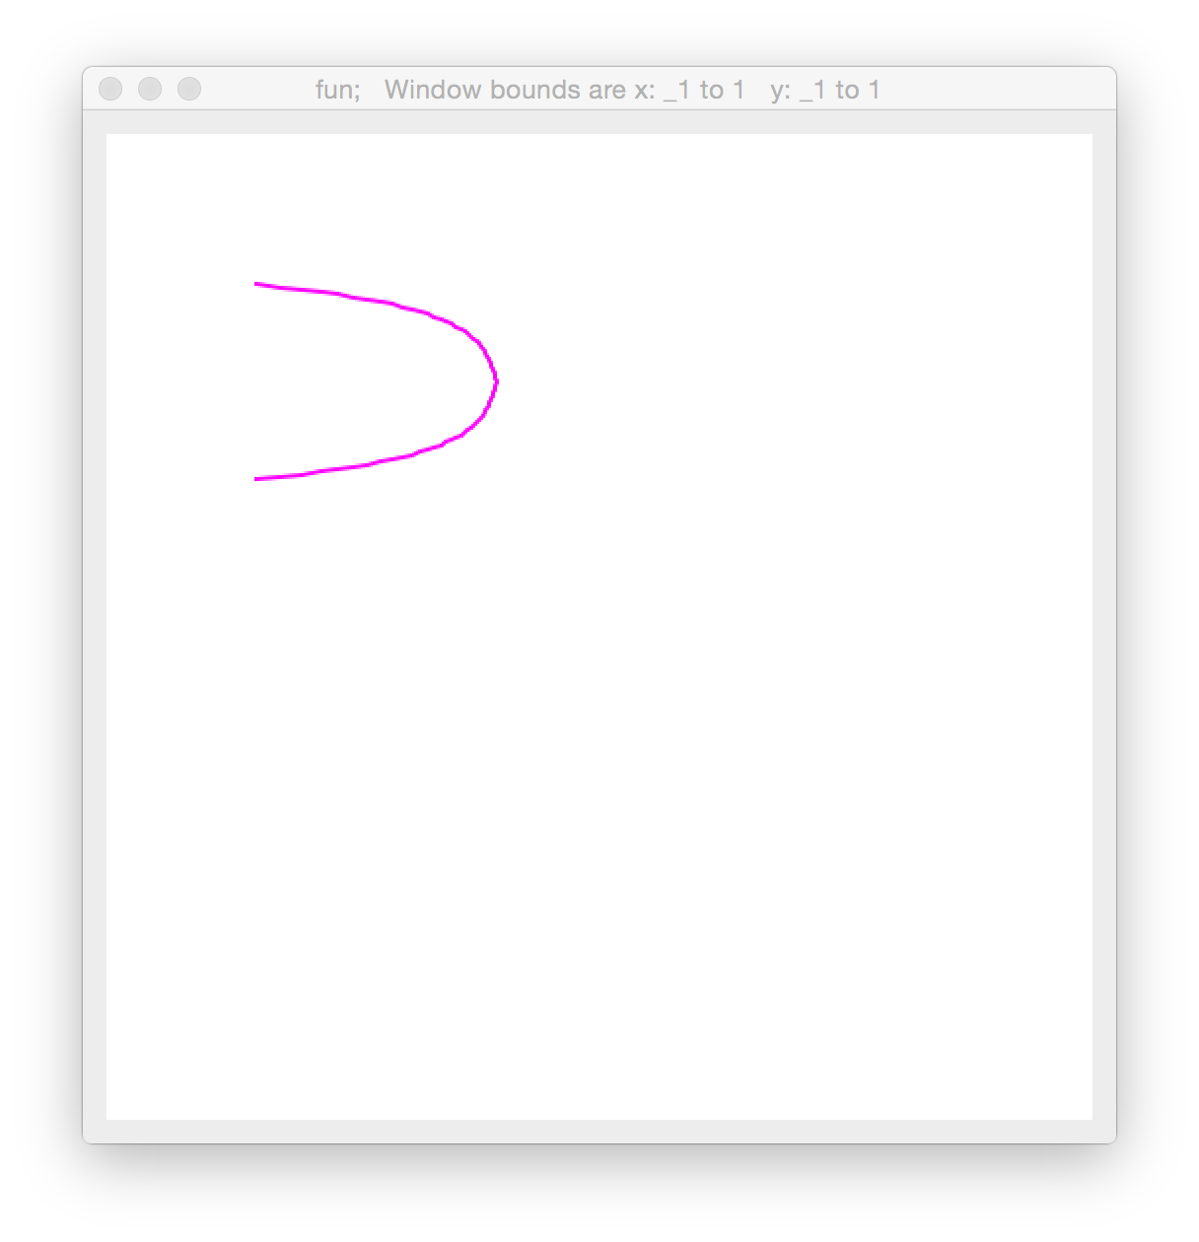
NB. make curve shorter and add extra z=1 coordinate
curve =: ((|: ((0.005*80*0.5) -~ 0.005 * i.80) ,:
((|. (^0.1*i.40)), (^0.1*i.40))%100) ,. 1)
NB. draw a translated, rotated curve
255 0 255 dline curve mp (trans 0.5 0.2) mp (rotm 1r2p1)

Slide 107
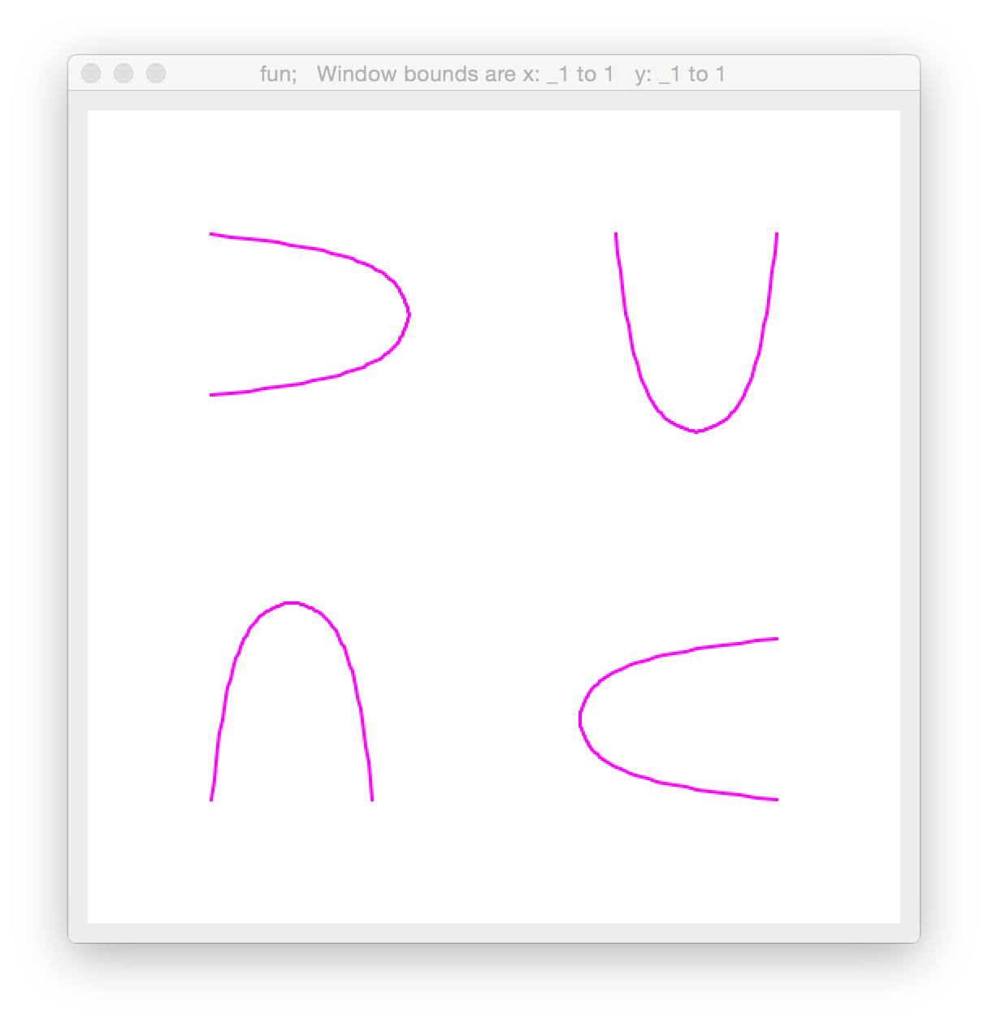
NB. define a verb for drawing curve with translate + rotate
NB. use dyad form, x=translate, y=rotate
dcurveRot =: dyad define
255 0 255 dline curve mp (trans x) mp (rotm y)
)
dclear''
0.5 0.2 dcurveRot 1r2p1
0.5 0.2 dcurveRot 2r2p1
0.5 0.2 dcurveRot 3r2p1
0.5 0.2 dcurveRot 4r2p1

Slide 108
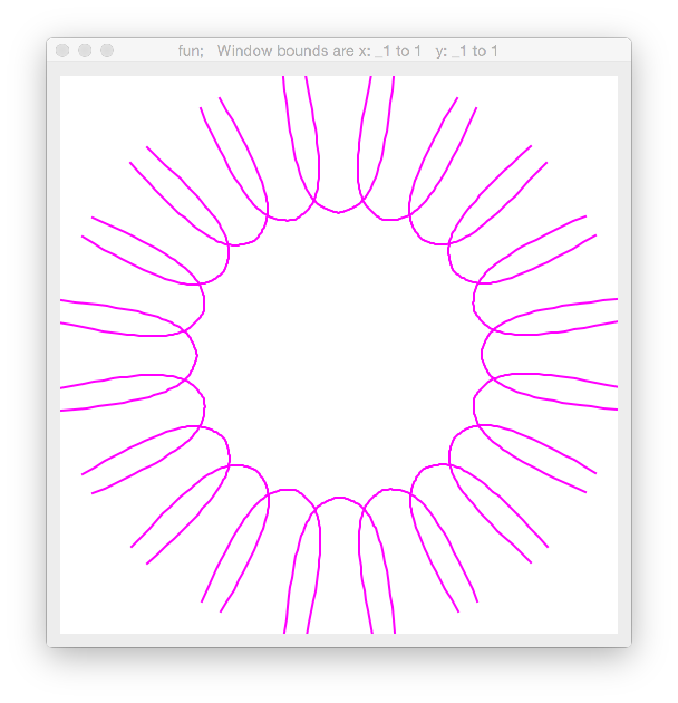
NB. draw many!
dclear''
(0 0.5 & dcurveRot)"0 (20 1 $ 1r10p1 * i.20)
Notes:
Notice no x translation

Slide 109
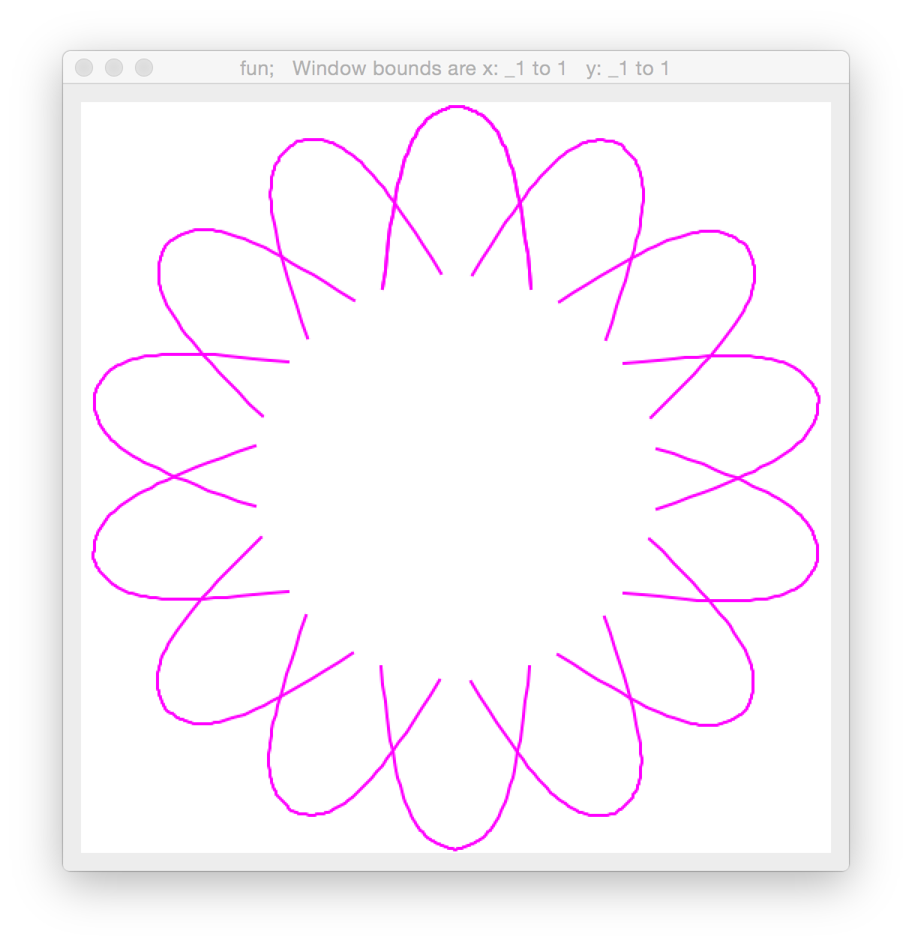
NB. unrotate by pi as the last step before drawing,
NB. and eliminate x-coordinate of translation parameter
dcurveRot =: dyad define
255 0 255 dline curve mp (rotm _1p1) mp (trans 0,x) mp (rotm y)
)
dclear''
0 dcurveRot"0 (15 1 $ 1r7p1 * i.15)
Notes:
Notice no x translation

Slide 110
NB. generate 15 rotations as multiples of pi/7
rotations =: (15 1 $ 1r7p1 * i.15)
NB. generate 4 translations as multiples of 0.2
translations =: 0.2 * i.4
NB. draw each rotation/translation pairing
dclear''
(60$translations) dcurveRot"0 (60$rotations)
Notes:
Notice no x translation

Slide 111
Challenge!
Generate x,y values for an exponential function.
TODO: Find two solutions using all of these cards simultaneously:
5x
s
1x
1x
1x
2x
1x
1x
1x
1x
1x
2x

Slide 113
Live for the destiny that aches for you

